Slide 1

Vending Machine in KFUPM Campus
ISE 490, Term 211

Slide 2
Acknowledgements
First, we thank God who helps and support us throughout our life. we would like to thank our Doctor Dr. Mohammad AlDurgam for his advice and guidance throughout our project. Also, we thank both KFUPM and SE department for allowing us to reach this point in addition, we also thank Dr. Mohammed Al-Abdel aal, Dr. Anas Alghazi, and Dr. Salih Daffua for their advice and support.

Slide 3
Introduction
Students at KFUPM Dorms face problems with food because restaurants at KFUPM mall and University restaurant close early, which make getting food hard and expensive for the students. An easy way to solve this problem and what is our project focus on is by using a vending machine. The process of operating the vending machine has several problems, one of these problems is determining the right place that can serve the largest possible number of people, the second is that finding the best tour to fill the machine with items, and finally determining the appropriate type of vending machine. In our case, the machines will be distributed in the students’ buildings by using the total cover technique to make sure all the students can reach the vending machine in less than 4 minutes, also the Salesman problem will be applied to find the lowest path to refill the machines. Based on certain criteria the type of vending machines will be selected to ensure that the machine is the best choice.

Slide 4
Needs Statement
The students who live in the students' housing have a problem that they cannot easily get food. The students are busy during the day attending the classes or they have many homework and exams. So, they need a way to get food and drinks fast, cheap, and along the day. The university’s restaurant has specific periods, and many students have a conflict with these periods. So, we want to make it possible for students to get food and drinks every day 24 hours per day and in a short time, to give them more time to study. Also, we want to guarantee the food and drinks will be fresh every day. Furthermore, we want to minimize the overall cost.

Slide 5
Project Goals
Provide food and drinks to students all the time.
The food and drinks have suitable prices.
The students can get the food and drinks easily and in a short time.
Provide fresh and healthy food.
Minimize the required number of vending machines and their cost.
Finding the best locations for the vending machines.
Finding the best way to refill the vending machines.
Finding the best type of vending machine.

Slide 6
Project Assumptions and Constraints
Our project is on the students’ housing area only.
The food and drinks should be available all the time.
Every student can reach the vending machine in a maximum of 4 minutes from any building.
The vending machines will be in the center of the first floor of the selected buildings.
On average 50 m added to traveling distances to cover the time of traveling inside the buildings.

Slide 7
Customer Needs & Specifications
Provide food and drinks to students 24 hours every day.
The food and drinks have suitable prices.
The students can get the food and drinks easily and in a short time.
Provide fresh and healthy food.
Finding the best locations for the vending machines.
Finding the best way to refill the vending machines.
Minimize the required number of vending machines and their cost.
We reached these specifications by using google surveys shared with the students.

Slide 8
Problem Statement
Given:
1- Number of students in KFUPM dorms around 7000.
2- The number of Buildings is 43.
3-Distance between buildings.
4- Demand.
5-Data sheets for vending machines.
Assumptions:
1-Food and drinks will be made in the central kitchen.
2- Vending machines will be placed on the first floor in the center of the building.
3-The path that will be used to refill the vending machines is tarred road.

Slide 9
Solution and Validation
The solution is divided into three main parts:
Vending machine’s locations.
Refill movement.
Vending machine selection.

Slide 10
Vending machine’s locations.

Slide 11
Vending machine’s locations Solution Methodology
We will use Total Set Covering to find the minimum number of machines and their locations to cover all student housing.
The distances between buildings are approximated to be equal to the actual path, to get more realistic results.
We create a covering matrix to determine if building (i) cover building (j). Where our objective is that every student can reach the vending machine in a maximum of 4 minutes from any building, and the average human walking speed ≈ 80 m/min. So, to find the maximum covering distance:
4min × 80 m/min = 320 m, approximate it to 300m to guarantee to achieve our objective.
Also, it is important to consider the traveling time inside the building. 50m added to cover this time.

Slide 12
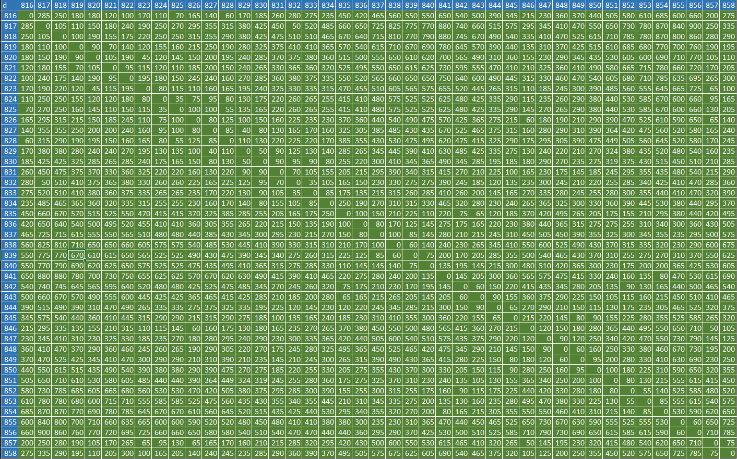
Vending machine’s locations Distance Matrix

Slide 13
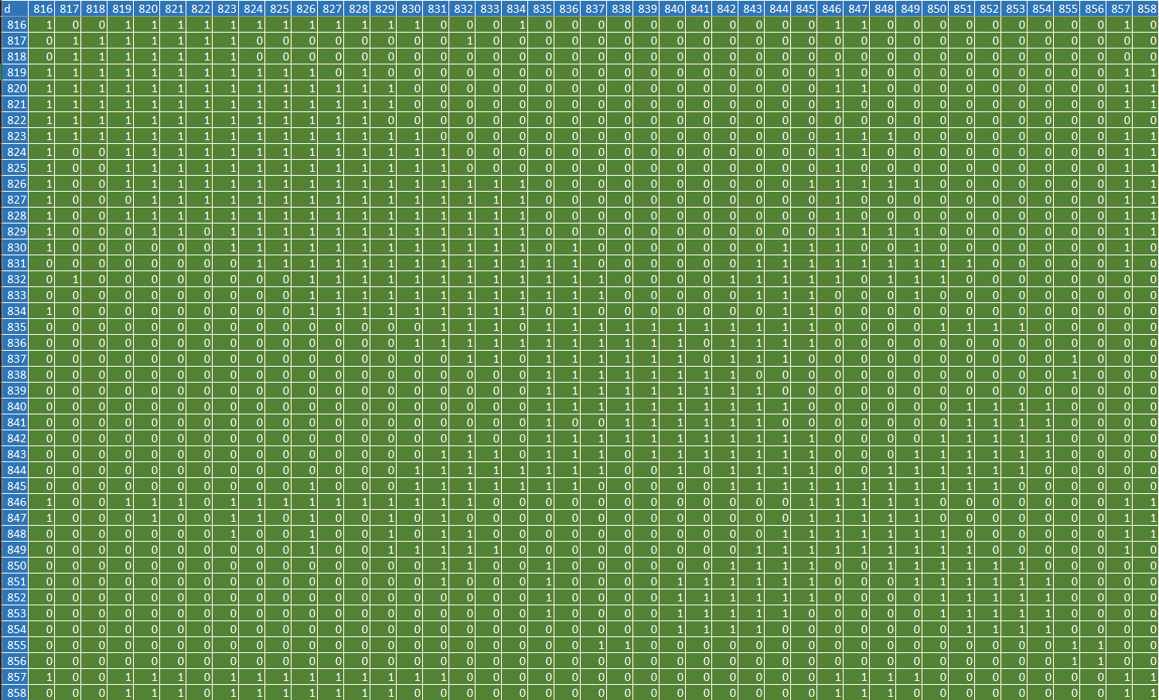
Vending machine’s locations Covering Matrix

Slide 14
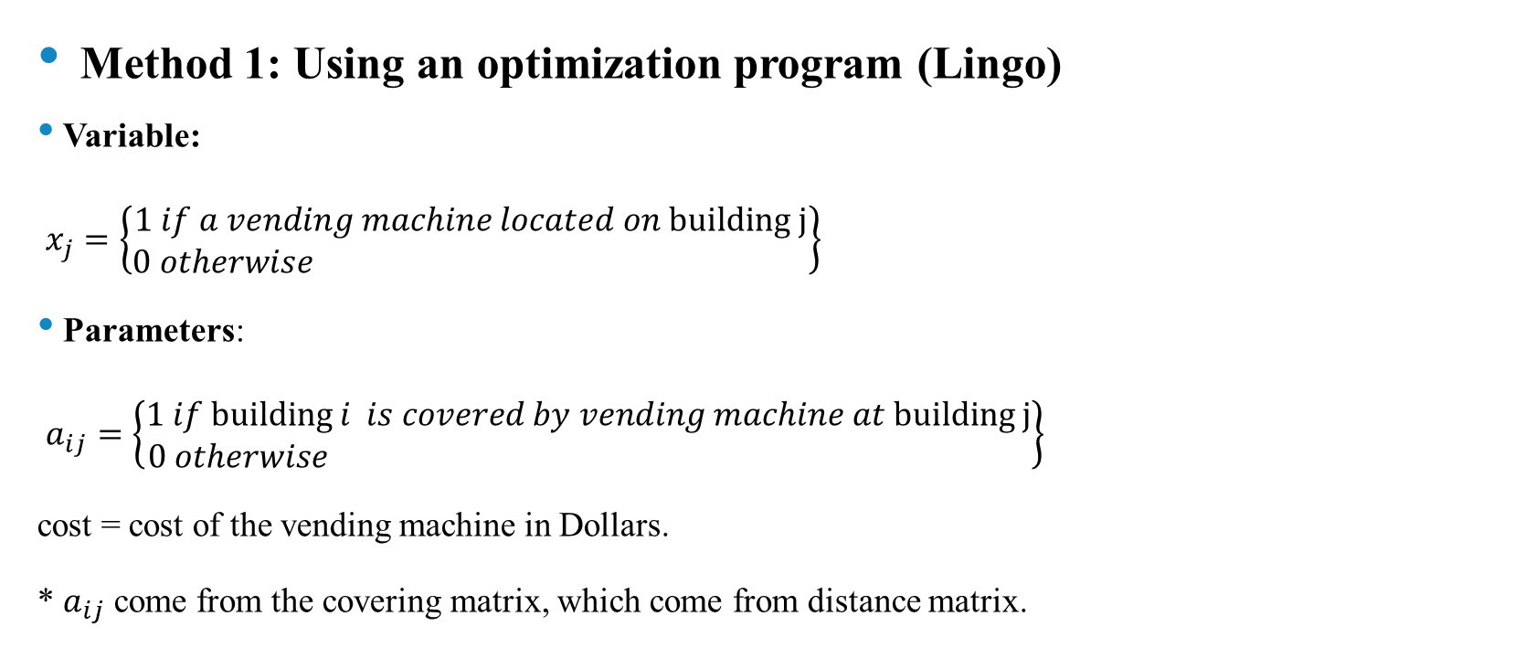
Vending machine’s locations Alternative Solutions
Method 1: Using an optimization program (Lingo)
Variable:
$x_{j}=\left\{\begin{aligned}1 if a vending machine located on building j \\ 0 otherwise \end{aligned}\right\}$
Parameters:
$a_{ij}=\left\{\begin{aligned}1 if building i is covered by vending machine at building j \\ 0 otherwise \end{aligned}\right\}$
cost = cost of the vending machine in Dollars.
* $a_{ij}$ come from the covering matrix, which come from distance matrix.

Slide 15
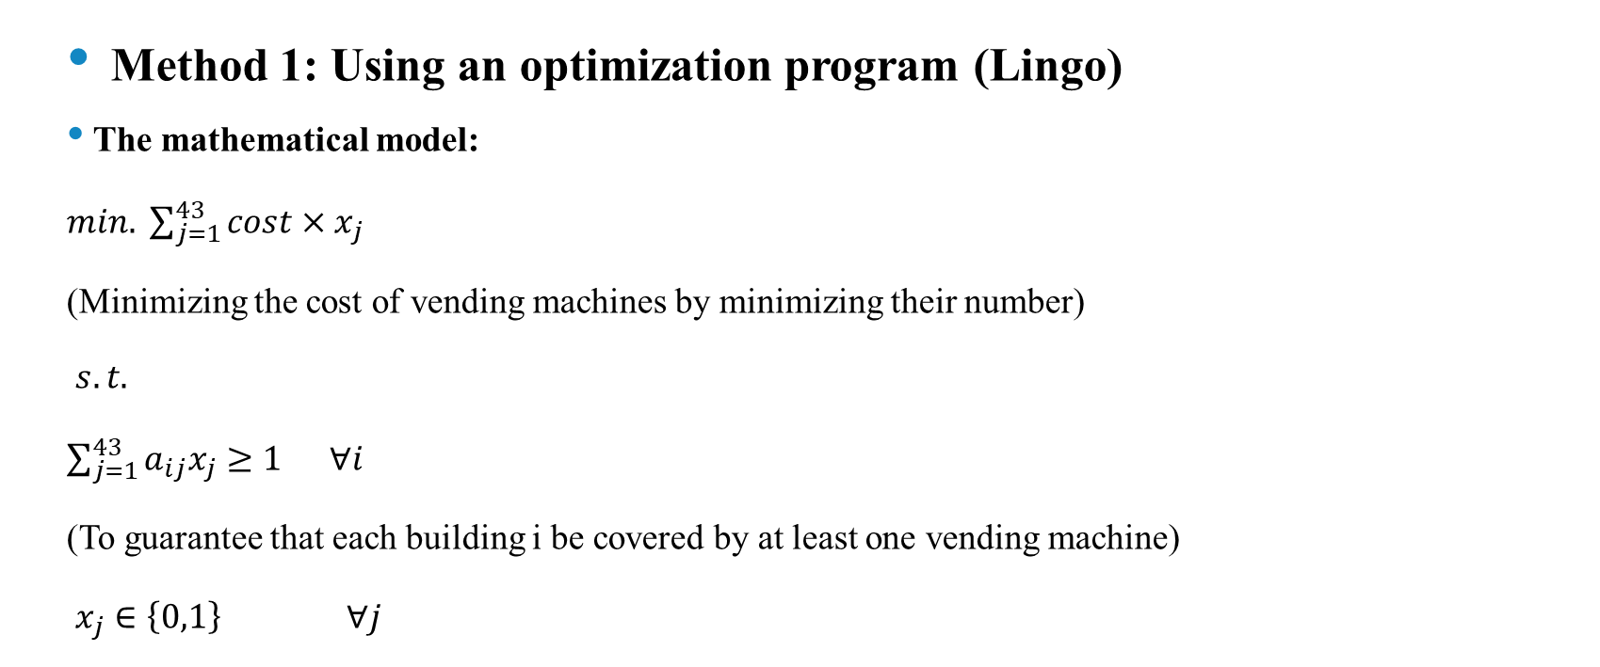
Vending machine’s locations Alternative Solutions
Method 1: Using an optimization program (Lingo)
The mathematical model:
$min. \sum_{j=1}^{43}{cost×x_{j}}$
(Minimizing the cost of vending machines by minimizing their number)
$s.t.$
$\sum_{j=1}^{43}{a_{ij}x_{j}}≥1 ∀i$
(To guarantee that each building i be covered by at least one vending machine)
$x_{j}∈\left\{0,1\right\} ∀j$

Slide 16
Vending machine’s locations Alternative Solutions
Method 1: Using an optimization program (Lingo)
The Lingo code:
!Total Cover Distance;
Sets:
l/1..43/:x;
cover(l,l): a;
endsets
data:
cost=1500;
a = @OLE('C:\Users\Mohammed\Desktop\211\ISE 490\Total Cover Distance.xlsx','A');
Enddata
Min = @sum(l(j):cost*x(j));
@for(l(i):@sum(cover(i,j):a(i,j)*x(j)) >= 1);
@for(l(j):@bin(x(j)));

Slide 17
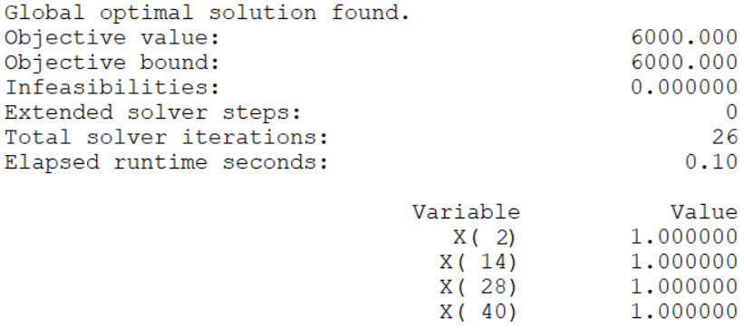
Vending machine’s locations Alternative Solutions
Method 1: Using an optimization program (Lingo)
The solution:
The vending machines will be located on the following buildings#: 817, 829, 843, 855.

Slide 18
Vending machine’s locations Alternative Solutions
Method 2: Heuristic
The first step is calculating the sum of every available column in the covering matrix, which represents the summation of the number of buildings covered by the vending machine at building (j).
Then place a vending machine in the building with the column with the maximum sum.
Update the matrix by deleting the covered buildings.
Repeat the previous steps until covering all buildings (all the summation equal to zero).

Slide 19
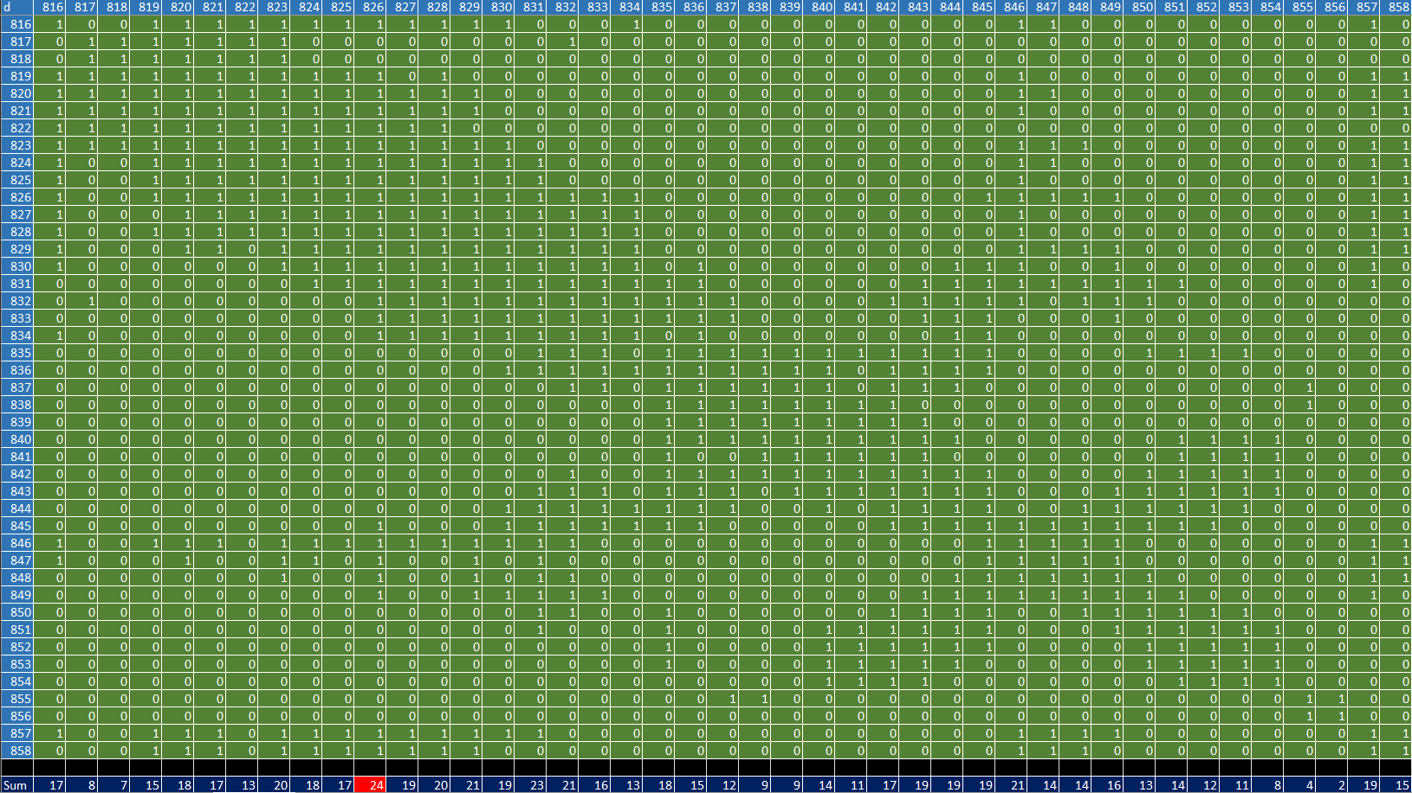
Vending machine’s locations Alternative Solutions
Method 2: Heuristic
Iteration 0:

Slide 20
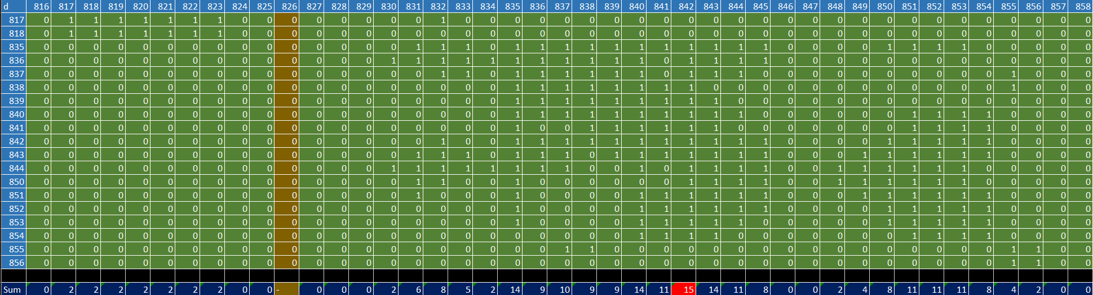
Vending machine’s locations Alternative Solutions
Method 2: Heuristic
Iteration 1:
Iteration 2:

Slide 21
Vending machine’s locations Alternative Solutions
Method 2: Heuristic
Iteration 3:
Iteration 4:
The Solution:
The vending machines will be located on the following buildings#: 823, 826, 842,856.

Slide 22
Vending machine’s locations Solution Evaluation
Both solutions have the same number of vending machines, the difference is the locations. So, we will compare the total distance between buildings and nearest vending machines by simple Lingo code.
Sets:
b/1..43/;
v/1..4/;
bv(b,v):vending;
endsets
data:
vending = @OLE('C:\Users\Mohammed\Desktop\ISE 490\Total Cover Distance.xlsx',’S_1 / S_2');
Enddata
Min = @sum(b(i):@min(v(j): vending(i,j)));
The total distance for method 1 (817, 829, 843,855) = 5655 meter.
The total distance for method 2 (823, 826, 842,856) = 5745 meter.

Slide 23
Vending machine’s locations Best Solution Validation
The locations from method 1 (Using an optimization program, buildings 817, 829, 843,855) are the best places for the vending machines.
Where they cover all students housing and minimize the total distance and the number of the vending machines.

Slide 24
Refill movement

Slide 25
Refill movement
In the Refill movement problem, our target is to come up with the lowest distance that is needed to refill the vending machines with food and drinks by using the Traveling salesman Technique.
Our assumption was the food and drinks will be made at the Central kitchen starting and ending point will be at Central Kitchen.
The first step was to calculate the distances between the Central kitchen and the buildings that contain Vending machines, then by using the distances between the buildings that contain Vending machines and the Central Kitchen we can form a matrix distance that will help us to find the shortest distance

Slide 26
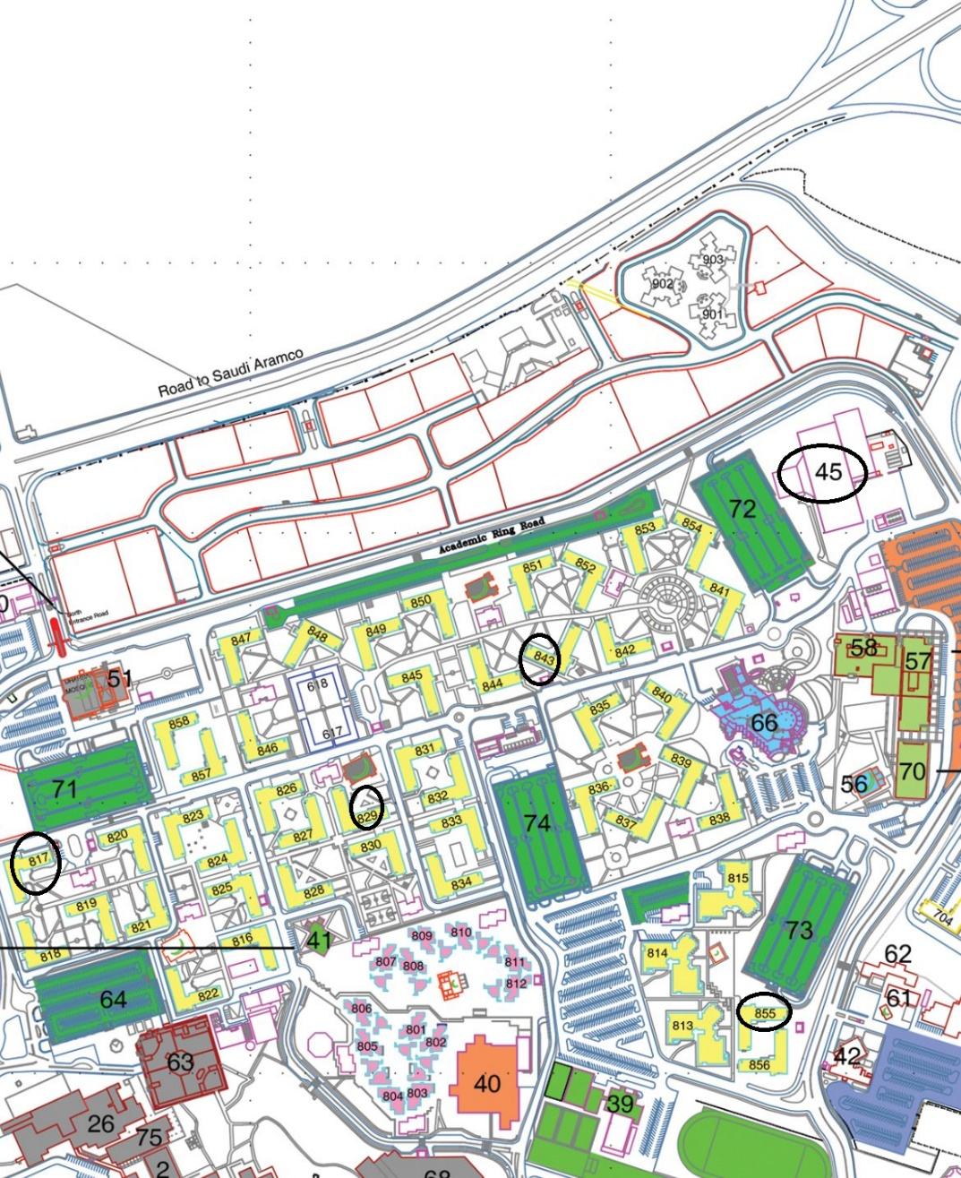
The location of the vending machines

Slide 27
The distances for refill movement.
817 | 829 | 843 | 855 | S&E point | B/B
1100 | 800 | 450 | 750 | 0 | S&E point
840 | 480 | 800 | 0 | 750 | 855
650 | 350 | 0 | 800 | 450 | 843
380 | 0 | 350 | 480 | 800 | 829
0 | 380 | 650 | 840 | 1100 | 817

Slide 28
Refill movement
In this section, our goal is to find the best path to reduce the total distance needed to refill the vending machines with food and drinks, to find the best path there are two methods
Method 1: Using an optimization program
Method 2: Reversal Heuristic

Slide 29
Method 1: Using an optimization program (Lingo)
Parameters:
i and j, represent the location of the building machines and starting and ending point.
i, j $∈\left\{1….5\right\}$
1 = Central kitchen
2 = Building# 855
3 = Building# 843
4 = Building# 829
5 = Building# 817
$d_{ij}$ = the distance from location i to location j
Variable:
$x_{ij}\left\{\begin{aligned}1 if path i to j selected \\ 0 otherwise \end{aligned}\right\}$
The mathematical model:
$min. \sum_{i=1}^{5}{\sum_{j=1}^{5}{d_{ij}}×x_{ij}}$ (Minimize the sum of all the distance that will be calculated)
$s.t.$
$\sum_{i=1}^{5}{x_{ij}}=1 ∀i$ (To make sure the building will be visited once time)
$\sum_{j=1}^{5}{x_{ij}}=1 ∀j$ (To make sure the building will be leaved once time)
$x_{ij}∈\left\{0,1\right\} ∀ i, j$

Slide 30
The Lingo code:
sets:
i/1..5/:e;
j/1..5/;
dij(i,j):dist,x;
endsets
data:
dist=10000 750 800 800 1100
750 10000 380 480 840
800 380 10000 140 485
800 480 140 10000 380
1100 840 485 380 10000 ;
min=@sum(dij(t,k):dist(t,k)*x(t,k));
@for(j(p):@sum(i(o):x(o,p))=1);
@for(i(a):@sum(j(z):x(a,z))=1);
@FOR(i(n):@FOR(j(w)|n#NE#w #and# w#ge#2 #and# n#ge#2:e(n)+1<=e(w)+5*(1-x(n,w))));
@for(i(r)|r#gE#2:e(r)>=0);
@for(dij(y,u):@bin(x(y,u)));

Slide 31
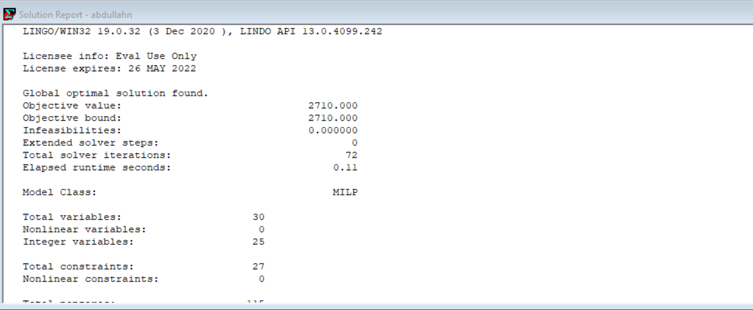
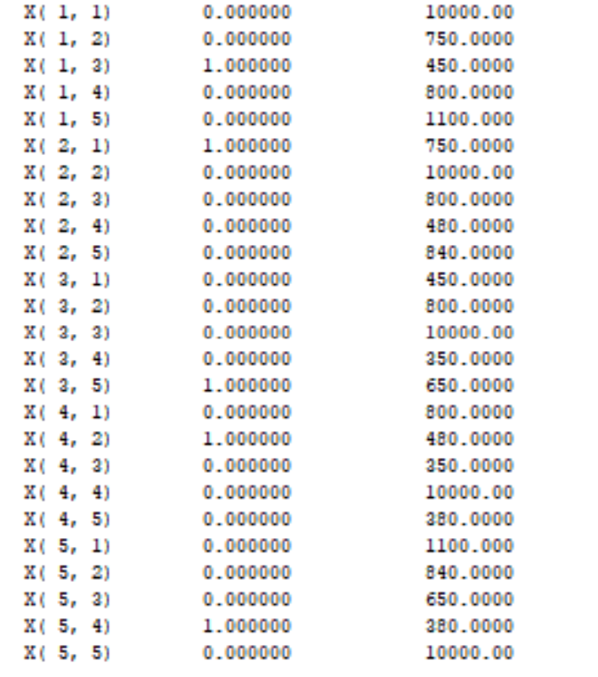
The solution:
The solution is (Central Kitchen-843-817-829-855- Central Kitchen) Total distance = 2710 meter.

Slide 32
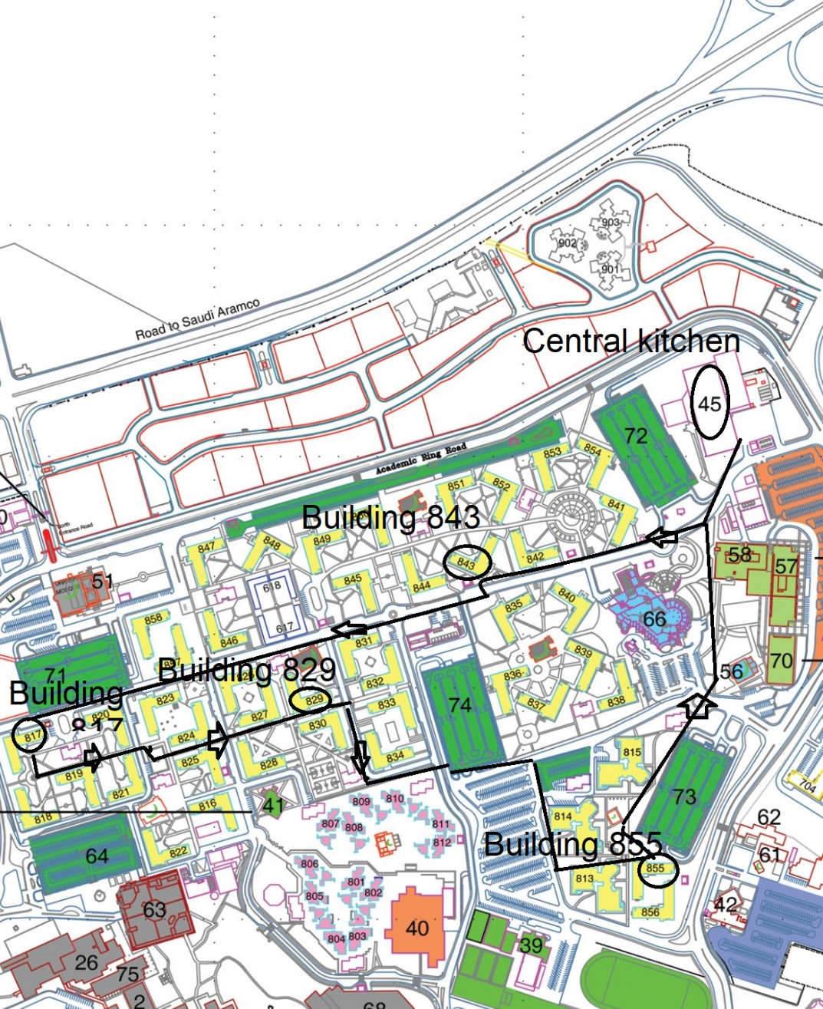
Direction of the refill movement.

Slide 33
Method 2: Reversal Heuristic
Staring with random close tour that start and end at the Central Kitchen, then we swap the order until we find the shortest distance.
We can find a neighbor tour in which one arc is reversed. This reversal is called “two-at-a-time” reversal.
We can find a neighbor tour in which two arcs are reversed. This reversal is called “three-at-a-time” reversal.
and so on, since our problem is symmetric, we have up to n-2 at a time
We stop until we find the lowest distance

Slide 34
The distances for refill movement.
817 | 829 | 843 | 855 | S&E point | B/B
1100 | 800 | 450 | 750 | 0 | S&E point
840 | 480 | 800 | 0 | 750 | 855
650 | 350 | 0 | 800 | 450 | 843
380 | 0 | 350 | 480 | 800 | 829
0 | 380 | 650 | 840 | 1100 | 817

Slide 35
Method 2: Reversal Heuristic
Starting with (S&E point-843-829-817-855- S&E point) as random selection
Z= 450+350+380+840+750= 2770 meter
Starting with (S&E point-843-829-817-855- S&E point) as random selection Z= 450+350+380+840+750= 2770 meter
Appling two at time
1-( S&E point-829-843-817-855- S&E point)
Z= 800+350+650+840+750 = 3390 meter
2-( S&E point-843-817-829-855- S&E point)
Z= 450+650+380+480+750=2710 meter
3-( S&E point-843-829-855-817- S&E point)
Z= 450+350+480+840+1100 = 3220 met

Slide 36
Method 2: Reversal Heuristic
Appling Three at time
1-( S&E point-817-829-843-855- S&E point)
Z=1100+380+350+800+750= 3380 meter
2-( S&E point-843-855-817-829-S&E point)
450+800+840+380+800=3270 met
Appling Four at time
1- ( S&E point-855-817-829-843- S&E point)
750+840+380+350+450= 2770 meter
Best solution is ( S&E point-843-817-829-855- S&E point)
Z= 450+650+380+480+750=2710 meter

Slide 37
Vending machine selection

Slide 38
Vending machine selection
After we found the best number of vending machines that satisfy our assumptions and the best tour to refill the vending machines, now we should find the best selection of vending machines using TOPSIS and analytic hierarchy process (AHP) furthermore we will check our constancy using eigenvector.
First, we should set the criteria then we should put weight for each one of them based on our preferences, TOPSIS method will be applied first then AHP. Five criteria have been chosen which are the cost, various payment methods, capacity, the efficiency of energy, and lastly the appearance and these are the weights 0.45, 0.15, 0.2, 0.1, 0.1 respectively, the cost has the highest weight because the prices of the vending machines are high compared with other devices, and we want the vending machine to have good quality with minimum cost possible.
We chose five different vending machines from various websites like Alibaba, online vending, and Sam’s club, the pictures of the vending machines and data sheets will be attached.

Slide 39
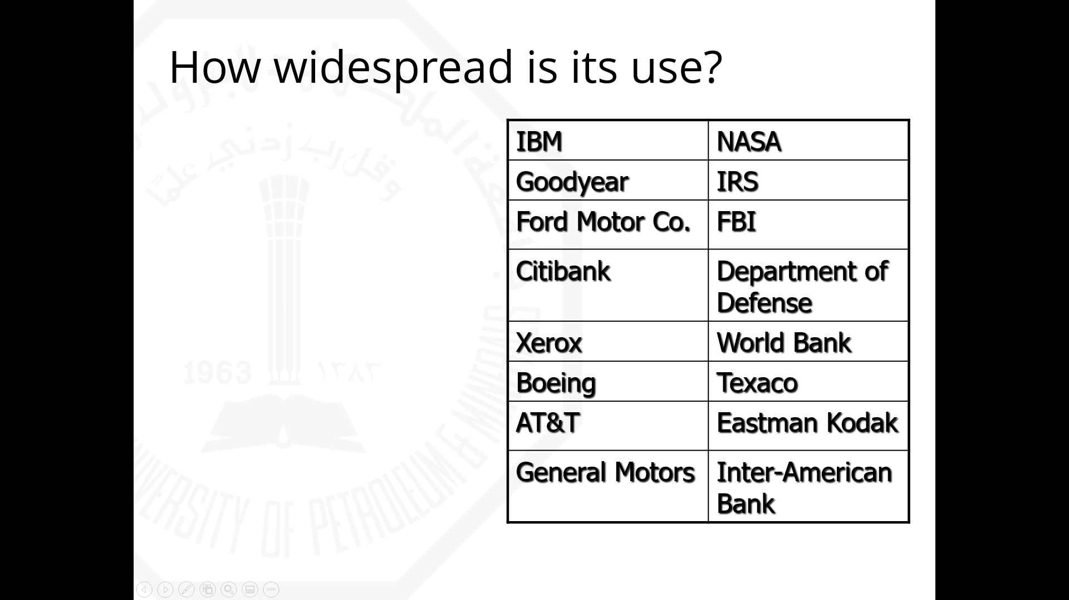

Slide 40
TOPSIS method:
It is referred to Technique of Order Preference by Similarity to Ideal Solution, and this method considers three types of attributes or criteria:
Qualitative benefit attributes/criteria
Quantitative benefit attributes
Cost attributes or criteria
In this method two artificial alternatives are hypothesized:
Ideal alternative: the one which has the best level for all attributes considered.
Negative ideal alternative: the one which has the worst attribute values.
TOPSIS selects the alternative that is the closest to the ideal solution and farthest from negative ideal alternative.

Slide 41
The following table will show the differences between vending machines with respect to the selected criteria, Cost in dollar, Various Types of Payment Methods (VTPM), Capacity (CP) in number of pieces, Electric Efficiency (EE) in Watt/Hour, and Appearance in (AP).
The VTPM and the AP we evaluated them subjectively, so we put score for them from 1-5 therefore no units applicable for both.
 | COST($) | VTPM | CP(Pcs) | EE(watt) | AP
WEIGHT | 0.45 | 0.15 | 0.2 | 0.1 | 0.1
FC6601 | 1500 | 1 | 300 | 350 | 3
CRANE764 | 2995 | 3 | 375 | 250 | 2
SEL40 | 4689 | 3 | 630 | 25 | 4
35890117 | 4574 | 3 | 353 | 125 | 2
ZG-CSC | 2213 | 5 | 550 | 510 | 5

Slide 42
Step1 :
Each criterion has it is own unit, so we cannot go for further analysis until the units become uniform, and to do this we should construct normalized decision matrix:
 | COST ($) | VTPM | CP (Pcs) | EE(watt) | DE
WEIGHT | 0.45 | 0.15 | 0.2 | 0.1 | 0.1
FC6601 | 1500 | 1 | 300 | 350 | 3
CRANE764 | 2995 | 3 | 375 | 250 | 2
SEL40 | 4689 | 3 | 630 | 25 | 4
35890117 | 4574 | 3 | 353 | 125 | 2
ZG-CSC | 2213 | 5 | 550 | 510 | 5
∑x^2 | 59025591 | 53 | 1054634 | 461350 | 58
(∑x^2)^0.5 | 7682.811 | 7.28011 | 1026.954 | 679.2275 | 7.615773

Slide 43
normalize scores or data as follows:
r_{ij} = x_{ij}/ (Σx²_{ij})^{0.5} for i = 1, …, m; j = 1, , n
 | COST | VTPM | CP | EE | DE
WEIGHT | 0.45 | 0.15 | 0.2 | 0.1 | 0.1
FC6601 | 0.195241 | 0.137361 | 0.292126 | 0.515291 | 0.393919
CRANE764 | 0.389831 | 0.412082 | 0.365158 | 0.368065 | 0.262613
SEL40 | 0.610323 | 0.412082 | 0.613465 | 0.036807 | 0.525226
35890117 | 0.595355 | 0.412082 | 0.343735 | 0.184033 | 0.262613
ZG-CSC | 0.288046 | 0.686803 | 0.535565 | 0.750853 | 0.656532

Slide 44
Step 2 :
The preferences of the decision maker are important, and it is the main part of the analysis, the weight is not a collective data, it is given by the decision maker to represent his desire, in this step we are going to Construct the weighted normalized decision matrix by multiplying each column of the normalized decision matrix by its associated weight, an element of the new matrix is:
v_{ij} = w_{j} r_{ij}
 | COST | VTPM | CP | EE | DE
WEIGHT | 0.5 | 0.15 | 0.2 | 0.1 | 0.1
FC6601 | 0.097621 | 0.020604 | 0.0584252 | 0.051529 | 0.039392
CRANE764 | 0.194916 | 0.061812 | 0.0730315 | 0.036807 | 0.026261
SEL40 | 0.305162 | 0.061812 | 0.122693 | 0.003681 | 0.052523
35890117 | 0.297677 | 0.061812 | 0.068747 | 0.018403 | 0.026261
ZG-CSC | 0.144023 | 0.10302 | 0.1071129 | 0.075085 | 0.065653

Slide 45
Step 3: Determine the ideal and negative ideal solutions.
Ideal solution:
A* = { v₁* , …, v_{n}*}, where
v_{j}* ={ max (v_{ij}) if j ∈ J ; min (v_{ij}) if j ∈ J' }
Negative ideal solution:
A' = { v₁' , …, v_{n}' }, where
v' = { min (v_{ij}) if j ∈ J ; max (v_{ij}) if j ∈ J' }
A* | 0.097621 | 0.10302 | 0.122693 | 0.003681 | 0.065653
A' | 0.305162 | 0.020604 | 0.0584252 | 0.075085 | 0.026261

Slide 46
Step 4: Calculate the separation measures for each alternative as follows:
The separation from the ideal alternative is:
S_{i} * = [ Σj (v_{j}*– v_{ij})² ] ^{½} i = 1, …, m
 | COST | VTPM | CP | EE | DE | S*=(∑vj*vij)^0.5
FC6601 | 0 | 0.006792 | 0.00413 | 0.002289 | 0.00069 | 0.117906435
CRANE764 | 0.009466 | 0.001698 | 0.002466 | 0.001097 | 0.001552 | 0.127592154
SEL40 | 0.043073 | 0.001698 | 0 | 0 | 0.000172 | 0.211999722
35890117 | 0.040023 | 0.001698 | 0.00291 | 0.000217 | 0.001552 | 0.215405551
ZG-CSC | 0.002153 | 0 | 0.000243 | 0.005099 | 0 | 0.086570976

Slide 47
Similarly, the separation from the negative ideal alternative is:
S'_{i} = [ Σj (v_{j}' – v_{ij})² ] ^{½} i = 1, …, m
 | COST | VTPM | CP | EE | DE | S'=(∑vj*vij)^0.5
FC6601 | 0.043073 | 0 | 0 | 0.000555 | 0.000172 | 0.209286078
CRANE764 | 0.012154 | 0.001698 | 0.000213 | 0.001465 | 0 | 0.124623132
SEL40 | 0 | 0.001698 | 0.00413 | 0.005099 | 0.00069 | 0.107780958
35890117 | 5.6E-05 | 0.001698 | 0.000107 | 0.003213 | 0 | 0.071228646
ZG-CSC | 0.025966 | 0.006792 | 0.00237 | 0 | 0.001552 | 0.191521336

Slide 48
Step 5: Calculating the relative closeness to the ideal solution C_{i}*
C_{i}* = S'_{i} / (S_{i}* +S'_{i} ) , 0 < C_{i}* < 1
Select the option with C_{i}* closest to 1.
 | Ci* | Ranking
FC6601 | 0.639642 | 1
CRANE764 | 0.494114 | 4
SEL40 | 0.337046 | 2
35890117 | 0.2485 | 3
ZG-CSC | 0.613454 | 5
As we can see from the above results , vending machine (FC6601) is the best selection that is satisfy our criteria, and we will do one more professional analysis using AHP to make sure that our selection is the best, before that we are going to find the weight and check our constancy using eigen vector and lambda max.

Slide 49
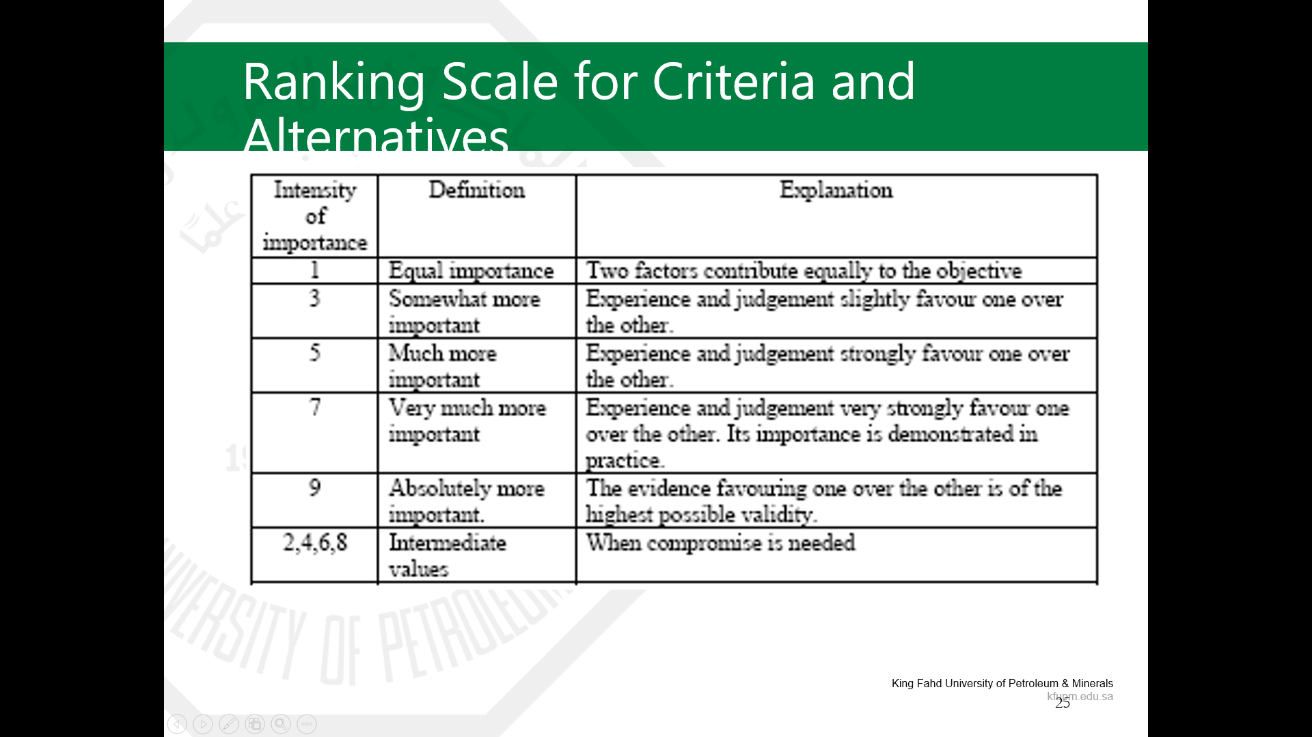
To find the weight, first we will rank the score of the criteria and alternatives relying on the next table:
A basic, but very reasonable, assumption: If attribute A is more important than attribute B and is rated at 9, then B must be absolutely less important than A and is valued at 1/9.

Slide 50
And we rated the criteria as following:
 | COST | VTPM | CP | EE | DE
COST | 1 | 4 | 3 | 5 | 7
DTPM | 1/4 | 1 | 1/2 | 2 | 5
CP | 1/3 | 2 | 1 | 4 | 6
EE | 1/5 | 1/2 | 1/4 | 1 | 2
DE | 1/7 | 1/5 | 1/6 | 1/2 | 1
Total | 1.93 | 7.70 | 4.92 | 12.50 | 21.00

Slide 51
Then we will divide each cell in each column by the associated total of that column to normalize the scores , then we will take the average of each row to find the required weights as follows:
 | COST | VTPM | CP | EE | DE | Weight
COST | 0.52 | 0.52 | 0.61 | 0.40 | 0.33 | 0.48
DTPM | 0.13 | 0.13 | 0.10 | 0.16 | 0.24 | 0.15
CP | 0.17 | 0.26 | 0.20 | 0.32 | 0.29 | 0.25
EE | 0.10 | 0.06 | 0.05 | 0.08 | 0.10 | 0.08
DE | 0.07 | 0.03 | 0.03 | 0.04 | 0.05 | 0.04

Slide 52
The next step is to generate a Consistency Ratio (CR) to see how consistent the decisions were compared to extensive samples of completely random decisions. The decision maker should be logically consistent and coherent, Incoherent who says E is less than likely than F, F is less transitivity property, now we will find the eigen vector in order to find (CR).

Slide 53
Step1 :
Take the squared power of matrix A, i.e., A²=A.A and Find the row sums of A² and normalize this array to find E₀.
 | COST | VTPM | CP | EE | DE | ROW SUM
COST | 5 | 17.9 | 10.41667 | 33.5 | 62 | 128.8167
DTPM | 1.780952 | 5 | 3.083333 | 9.75 | 18.75 | 38.36429
CP | 2.82381 | 8.533333 | 5 | 16.666667 | 32.33333 | 65.35714
EE | 0.894048 | 2.7 | 1.683333 | 5 | 9.4 | 19.67738
DE | 0.49127 | 1.554762 | 0.986905 | 2.7809524 | 5 | 10.81389
 |  |  |  |  | Total | 263.0294
E0
0.489743
0.145856
0.248479
0.074811
0.041113

Slide 54
Step2 :
Take the squared power of matrix A, i.e., A⁴= A². A² and Find the row sums of A⁴ and normalize this array to find E₁.
 | COST | VTPM | CP | EE | DE | ROW SUM
COST | 146.7031 | 454.7341 | 276.9381 | 855.5552 | 1607.331 | 3341.261
DTPM | 44.44454 | 138.6669 | 84.30188 | 260.6937 | 489.2635 | 1017.371
CP | 74.22074 | 231.1502 | 140.6913 | 434.3817 | 815.0762 | 1695.52
EE | 23.12 | 71.98 | 43.75 | 135.47 | 254.48 | 528.8071
DE | 12.95 | 40.27 | 24.46 | 75.87 | 142.66 | 296.2237
 |  |  |  |  | Total | 6879.182
E1 ,x
0.485706
0.147891
0.246471
0.076871
0.043061

Slide 55
Step3 :
Find D= E₁ - E₀.
IF the elements of D are close to zero, THEN X= E₁, STOP. ELSE set A:=A² , set E₀:=E₁ and go to Step 1. And here we have all elements of D are close to zero , so E₁ is the eigin vector X.
E1-E0
-0.00404
0.002036
-0.00201
0.00206
0.001948

Slide 56
Step4:
This step is to calculate λ_{max}, which will give you the Consistency Index and Ratio , Consider [Ax = λ_{max} x] where x is the Eigenvector.
A*x
2.502464
0.761599
1.270003
0.395697
0.22154
(A*x)/x
5.152218
5.149725
5.152746
5.14757
5.144798
AVG=ʎmax
5.149412

Slide 57
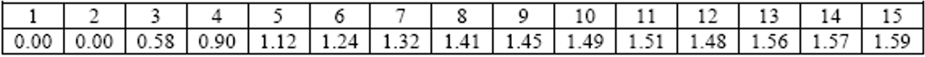
Step5 : Lastly, we should find the Consistency Index and Consistency Ratio depending on the next table :
The correction is minor relative to the actual values of the eigenvector elements if the inconsistency is less than 10%.
A CR of, say, 90% would indicate that the paired judgments are essentially random and absolutely untrusted.
CI= (λ max - n)/(n - 1)
CR= CI / 1.12
CI | 0.0373529
CR | 0.0333508
So, we can see that we are coherent because the CR value is less than 0.1

Slide 58
Analytic Hierarchy Process:
AHP develop a hierarchy of decision and define the alternative course of actions.
AHP algorithm is basically composed of two steps:
Determine the relative weight of decision criteria
Determine the relative rankings (priorities) of alternatives

Slide 59
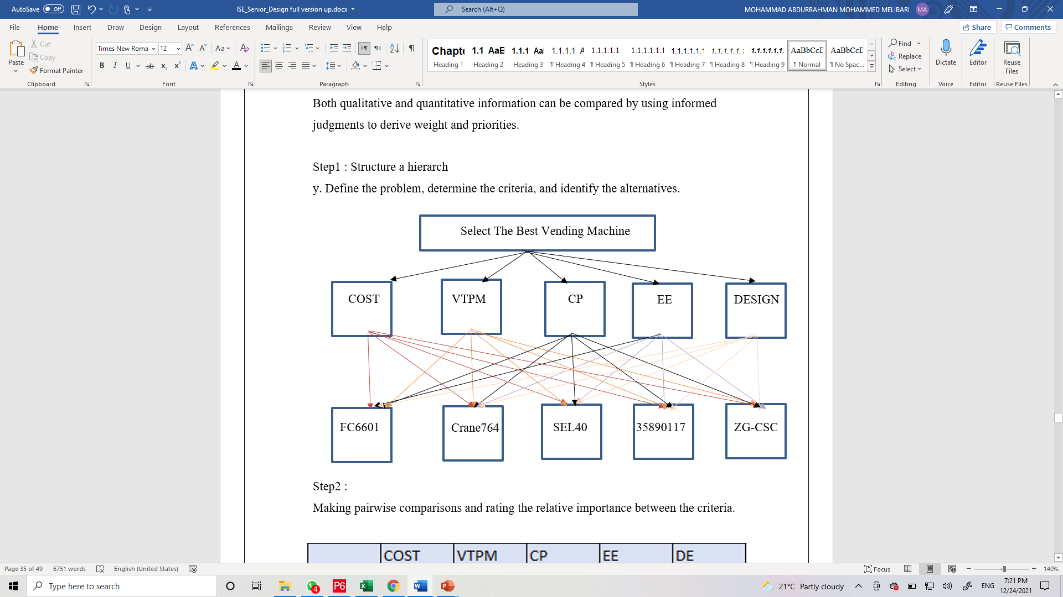
Step1 : Structure a hierarchy.
Define the problem, determine the criteria, and identify the alternatives.

Slide 60
Step2 :
Making pairwise comparisons and rating the relative importance between the criteria.
 | COST | VTPM | CP | EE | DE
COST | 1 | 4 | 3 | 5 | 7
DTPM | 1/4 | 1 | 1/2 | 2 | 5
CP | 1/3 | 2 | 1 | 4 | 6
EE | 1/5 | 1/2 | 1/4 | 1 | 2
DE | 1/7 | 1/5 | 1/6 | 1/2 | 1
This table show the pairwise comparison between criteria them self and we already did this step before while we were calculating the weights

Slide 61
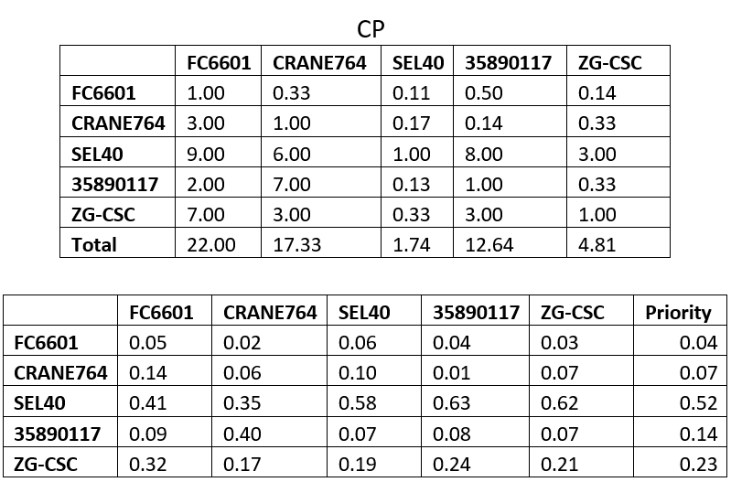
Step3:
In this step we will make a pairwise comparison between vending machines with respect to each criterion separately and score them as before from 1- 9, therefore 6 tables will be constructed, after that we will normalize each column and take the average of each row to get the priority of vending machines with respect the certain characteristic as follows:

Slide 62
Step4 :
In the last step we will figure out the impact of each criterion on the selection of the vending machine by multiplying the weights, and we will sum them up to find the composite for each type, then we will select the vending machine based on the highest composite.
 | CO | VTPM | CP | EE | DE | Composite | Ranking
Weight | 0.48 | 0.15 | 0.25 | 0.08 | 0.04 | NA | NA
FC6601 | 0.51 | 0.01 | 0.04 | 0.07 | 0.13 | 0.26 | 1
CRANE764 | 0.16 | 0.02 | 0.07 | 0.14 | 0.05 | 0.11 | 4
SEL40 | 0.05 | 0.02 | 0.52 | 0.48 | 0.26 | 0.20 | 2
35890117 | 0.07 | 0.02 | 0.14 | 0.28 | 0.05 | 0.10 | 5
ZG-CSC | 0.22 | 0.06 | 0.23 | 0.03 | 0.50 | 0.19 | 3
Finally, we have got the same result as the TOPSIS method, undoubtedly that illustrate vending machine (FC6601) is the best selection that satisfy the criteria.

Slide 63
Impact of the Proposed Solutions
Global:
The solutions would not affect or solve global issues, but the solutions can participate to increase people's satisfaction in so many institutions around the world.
Economic:
The project concentrates on increasing the student’s satisfaction and comfort at the university's budget expense. Students can pay less for food, instead of going to restaurants and paying a lot of money, they will pay less than half of the amount they pay to restaurants. Also, a job will be created in terms of the workers who are responsible for refilling the vending machines.

Slide 64
Impact of the Proposed Solutions
Environmental: In terms of sustainability:
A vending machine only uses approximately the same energy as a refrigerator.
Reduced servicing means less time spent on the roads, with less traffic and less carbon emission.
Delivery trucks can be pre-packed for each vending machine; meaning smaller, lighter, and more fuel-efficient vehicles can be used.
Societal:
Students' society will be enhanced as a result of this shift that may occur because of vending machine installation, by providing some capabilities such as food availability throughout the day. Furthermore, ease of access to vending machines within 4 minutes of residence. Also, implanting the solution will help to improve students' diet which consists of healthy food and beverages.

Slide 65
Ethical and Professional Responsibilities
Where we will place vending machines for students, it is important to consider their health. So, we will make sure that the food and drinks are healthy and fresh every day. We do not want to hear there is a student who has a stomachache or is poisoned because of vending machine's food or drink.
Moreover, the prices should be suitable and reasonable for the students. The main goal of our project is to help the students, not make a profit from their needs.

Slide 66
Summary
This project was worked on it based on a critical issue that the students at KFUPM faced a problem with food especially at night, and the obtained result will improve the quality of life at the students housing. The concentration was to guarantee that the students can reach the vending machines within 4 minutes, and to select vending machines that meet the ambitions of the students. The issues on this project were to collect the data especially the distance between 43 buildings and find both the best location for the vending machines and their number. The optimal solution for the location and the number of machines was determined by Set Covering model. Also, the best path for refilling the machines was found by using the sell man problem. Finally, the type of vending machines selected by TOPSIS and AHP methodologies.
From working on this project, our skills in mathematical modeling and decision making are improved dramatically, and we learned to collect data as a survey and analyze it.

Slide 67
Limitations and Future Study
For further work, if we have chance to improve the project, we will consider the Arena simulation to visualize refill movement and compare between situations. Also, we will do cost analysis, feasibility study, and forecasting to convince KFUPM to adopt our project.
Finally, we hope for future students to get benefit from our project as a reference and benchmark for their projects.

Slide 68
Thank you for listening

